Slide 1
Heart Disease Prediction using Data Mining Techniques
Team Members
D2_16
Poritosh Bardhan – 19BIT0079
Azeem Ullah Khan – 19BIT0131
Pranchal Sihare – 19BIT0144

Slide 2
Summary of Literature Survey
Many different data mining techniques were used in the research papers for heart disease prediction. These include Naïve Bayes, KNN, SVM, Decision Tree, Neural Networks and Regression.
All the research papers use the UCI repository for their dataset.
In most of the research papers Naïve Bayes gave the best results, which was followed by KNN.
Many research papers suggested that hybrid approaches might give better results than individual methods.
Some research papers used different tools like WEKA and ORANGE to implement the data mining techniques and produce their accuracies.
Many parameters accuracy and f-score were used to analyse the results for the various techniques used.

Slide 3
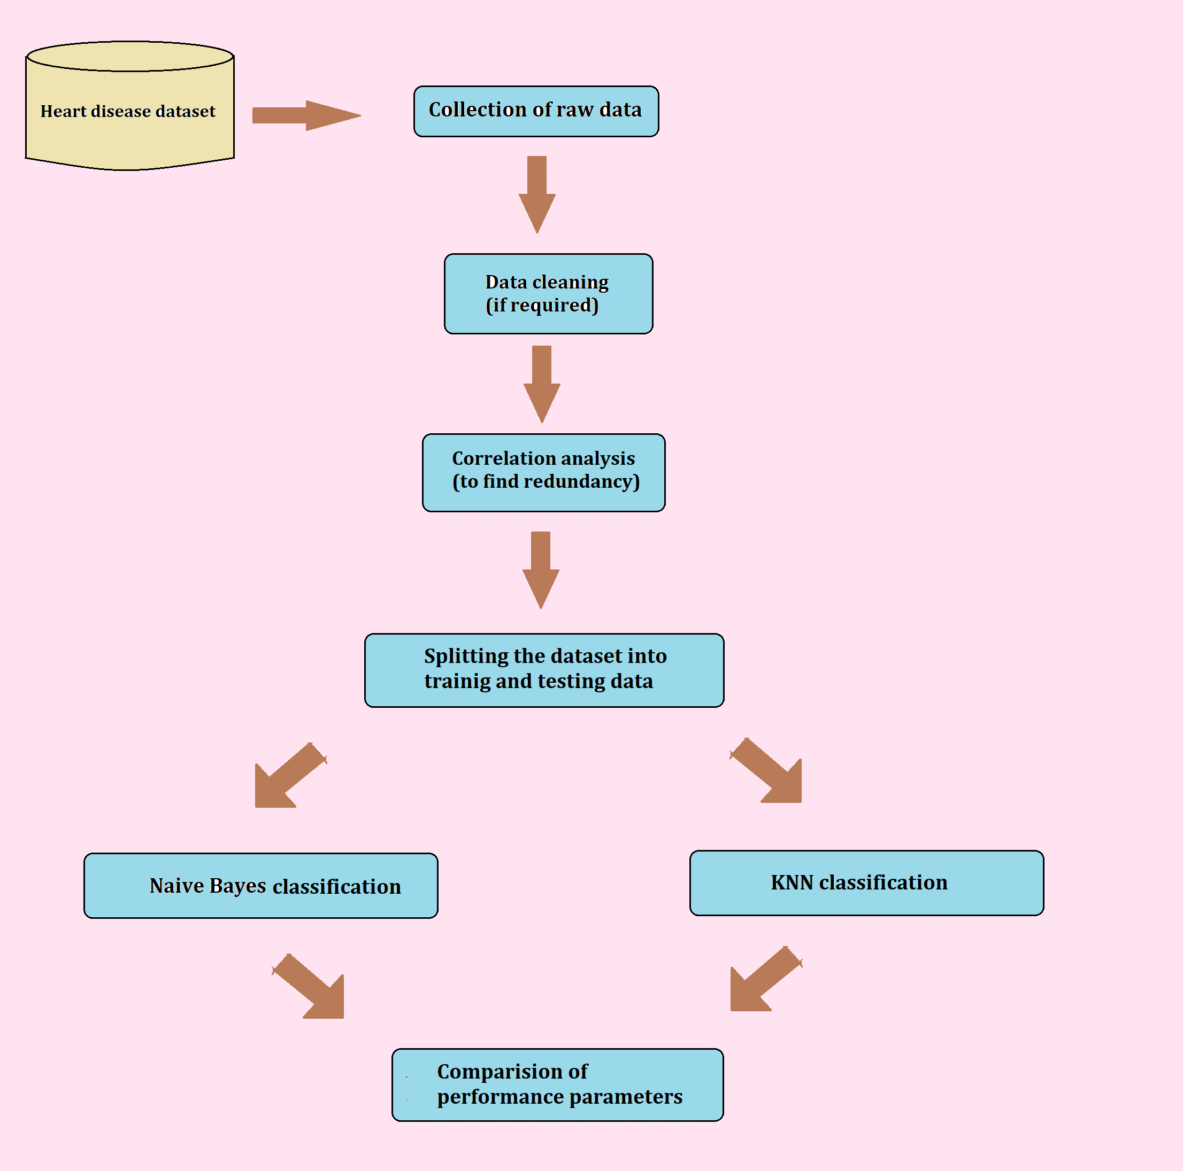
Flowchart

Slide 4
Proposed Algorithm
Naïve Bayes
Bayes’ Theorem is stated as:
P(C_{i}|X) = (P(X|C_{i}) * P(C_{i})) / P(X)
Informally, this can be written as
posteriori = likelihood x prior/evidence
Here, C_{i} indicates the different class labels target attribute can take.
X is the set of vectors having predictor attributes. X=(x₁,x₂,…,x_{n})
For final classification we derive the maximum posteriori, i.e., the maximal P(C_{i}|X)

Slide 5
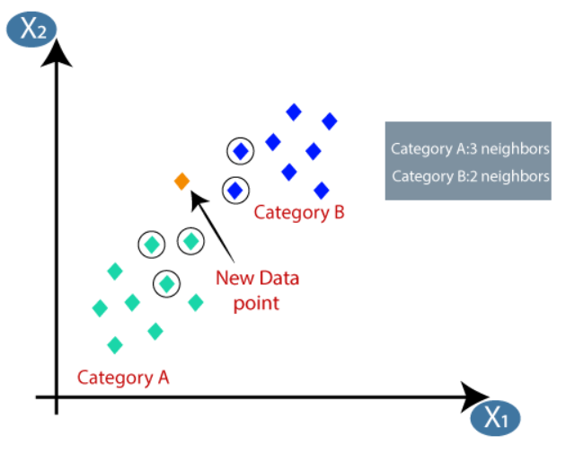
K-nearest Neighbor
KNN algorithm assumes the similarity between the new case/data and available cases and put the new case into the category that is most similar to the available categories.
Firstly the Euclidian distance is computed between the new data and all the existing data across all categories.
It then selects k number of data points which have the least Euclidian distance values.
The new data point is thus classified in the category which has the most number of data points.
For e.g. – In the below example if we have k value as 5 the since 3 points are there in A and 2 are there in B so we classify the new data in category A

Slide 6
Stepwise Algorithm
1. Import the dataset and check the type of the dataset.
2. Check for missing values in the dataset, if found then apply data cleaning by filling in the most probable value.
3. Check for redundancy in data among attributes using correlation analysis.
4. Apply the two classification techniques, namely, Naïve Bayes and KNN.
4.1. Create the training model for the classifiers.
4.2. Fit the training dataset into the model.
4.3. Using the model predict the values of testing dataset and generate accuracy scores.
5. Now generate the bar-charts for comparing accuracies of both models.

Slide 7
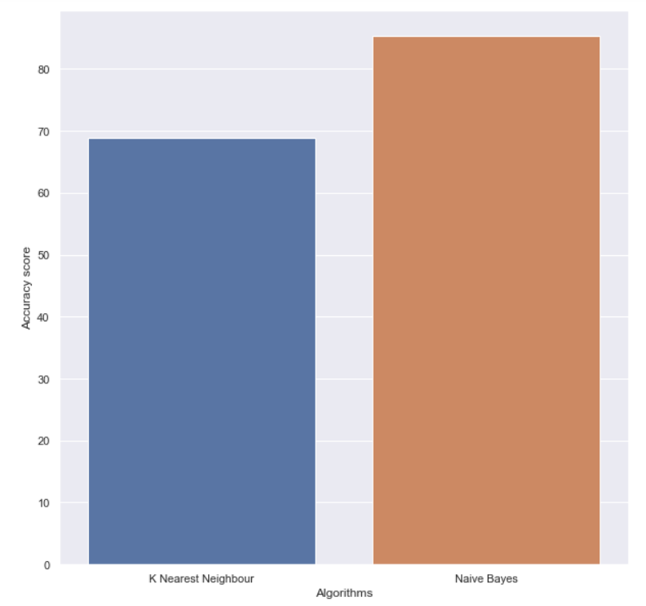
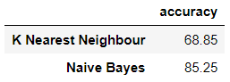
Comparison of Results
Accuracies
As observed in the graph the accuracy of naïve bayes is better than knn.

Slide 8


F-scores
These graphs show that f-score of naïve bayes is better than knn.

Slide 9
THANK YOU

